Slide 1

DEPARTMENT OF MATHEMATICS
AMRITA VISHWA VIDYAPEETHAM
COIMBATORE CAMPUS (INDIA)
April 2021

Slide 2
18CSC311 - MACHINE LEARNING
CASE STUDY - SENTIMENT ANALYSIS
ON AMAZON FOOD REVIEWS
PROJECT REPORT
TEAM MEMBERS :
AMITH P S CB.SC.I5DAS18003
KARTHIK RAJ VP CB.SC.I5DAS18016
LINCI FELICITA P CB.SC.I5DAS18022
PARAMESHWARI S CB.SC.I5DAS18026

Slide 3
OUTLINE
ABSTRACT
PROBLEM STATEMENT
OBJECTIVE
ABOUT THE DATASET
FUNCTIONALITIES & MODULES
ARCHITECTURE DIAGRAM
IMPLEMENTATION
SOFTWARE/TOOLS REQUIREMENT
REFERENCE

Slide 4
ABSTRACT
The world we see nowadays is becoming more digitalised. In this digitalishnced world e-commerce is taking the ascendancy by making products available within the reach of customers where the customer doesn't have to go out of their house. As now a day's people are relying on online products so the importance of a review is going higher. For selecting a product, a customer needs to go through thousands of reviews to understand a product. But in this prospering day of machine learning, going through thousands of reviews would be much easier if a model is used to polarize those reviews and learn from it. We used supervised learning method on a large scale amazon dataset to polarize it and get satisfactory accuracy.

Slide 5
Sentiment analysis is a natural language processing technique used to determine whether data is positive, negative or neutral. Sentiment analysis is often performed on textual data to help businesses monitor brand and product sentiment in customer feedback, and understand customer needs.
Amazon.com, Inc., is an American multinational technology company based in Seattle, Washington. Amazon focuses on e-commerce, cloud computing, digital streaming, and artificial intelligence. As they are strong in e-commerce platforms their review system can be abused by sellers or customers writing fake reviews in exchange for incentives. It is expensive to check each and every review manually and label its sentiment. So a better way is to rely on machine learning/deep learning models for that.
In this project, we will construct a machine learning model to predict the sentiment of the customer based on the reviews given.
PROBLEM STATEMENT

Slide 6
OBJECTIVE
To predict the sentiment (positive, negative or neutral) based on the reviews given by the customer.

Slide 7
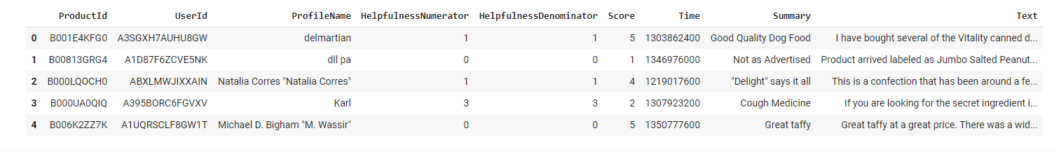
About the Dataset
Sample Dataset -
The data set consists of reviews of fine foods from amazon over a period of more than 10 years, till October 2012.
SHAPE - ( 568,454, 10)
COLUMNS - Product Id , User Id, Profile Name, Helpfulness Numerator, Helpfulness Denominator, Score, Time, Summary, Text

Slide 8
FUNCTIONALITIES
DATA CLEANING & TEXT
PREPROCESSING
DATA
EXPLORATION
DATA VISUALISATION
FEATURE
EXTRACTION
TRAINING AND TESTING
PREDICTION AND ACCURACY

Slide 9
MODULES
PANDAS
NUMPY
PLOTLY
SEABORN
SKLEARN
NLTK

Slide 10
NATURAL LANGUAGE PROCESSING (NLP)
Natural Language Processing (NLP) is a field of Artificial Intelligence (AI) that makes human language intelligible to machines. NLP combines the power of linguistics and computer science to study the rules and structure of language, and create intelligent systems (run on machine learning and NLP algorithms) capable of understanding, analyzing, and extracting meaning from text and speech.

Slide 11
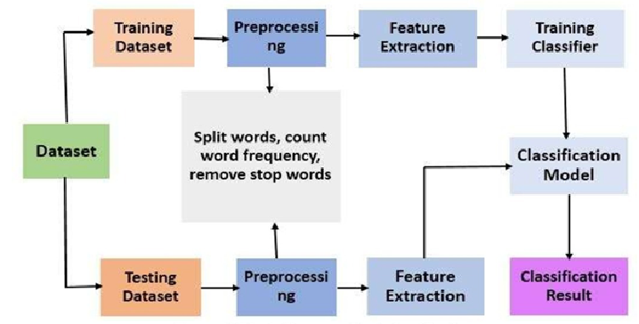
Architecture Diagram

Slide 12
Implementation

Slide 13
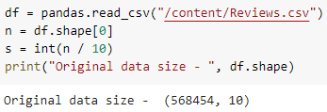
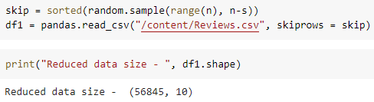
Reducing Data size
Processing huge dataset requires good RAM and lot of memory
Hence we reduced the size to 10 percent of the original data set.

Slide 14
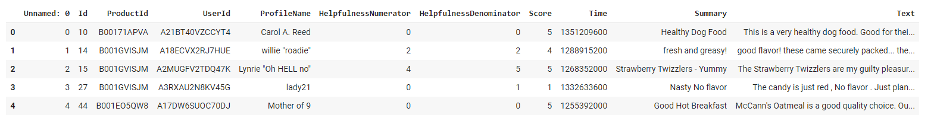
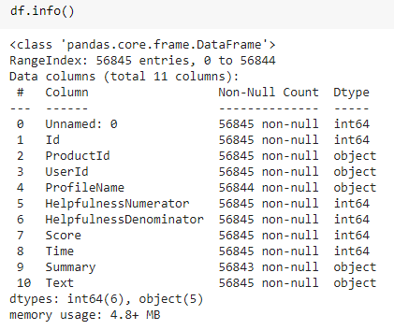
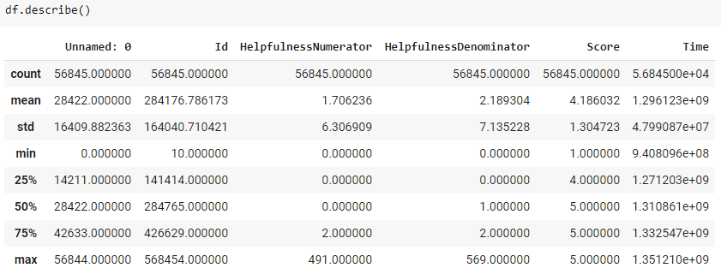

Data Exploration

Slide 15
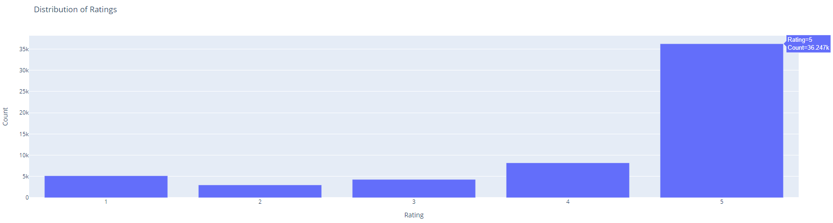
Data Visualisation
Count of Review for different Ratings

Slide 16
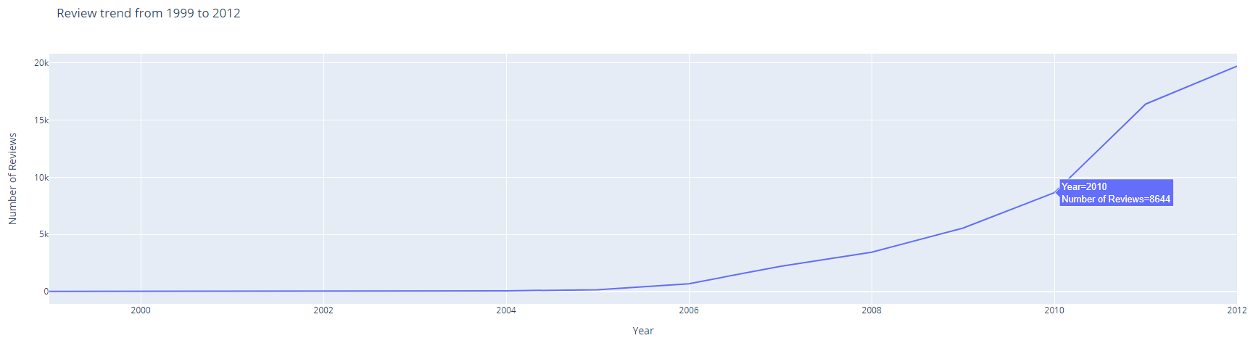
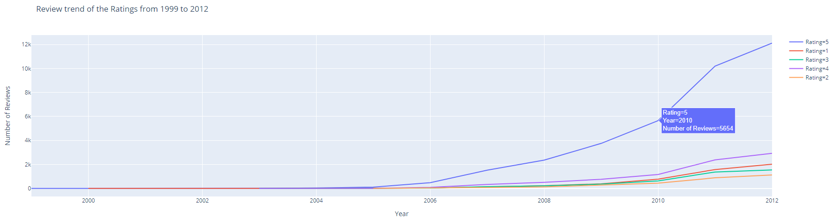

Slide 17
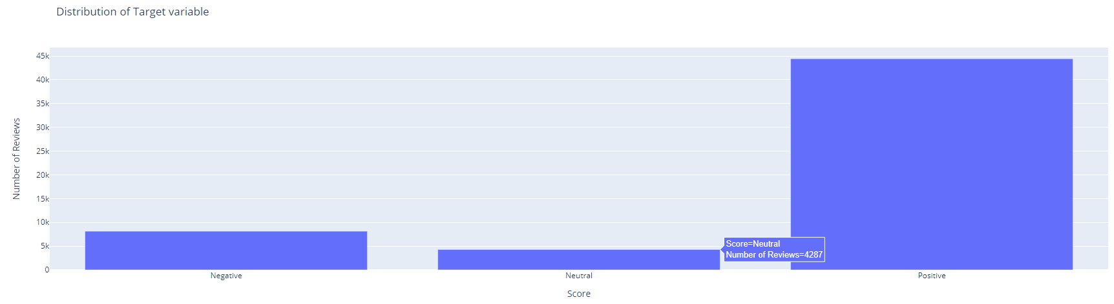
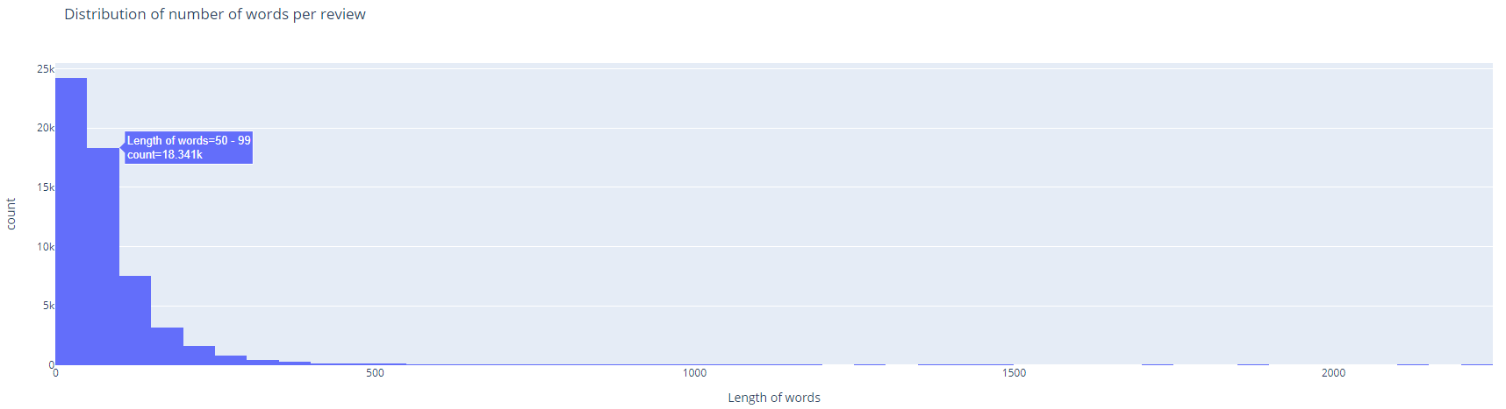

Slide 18
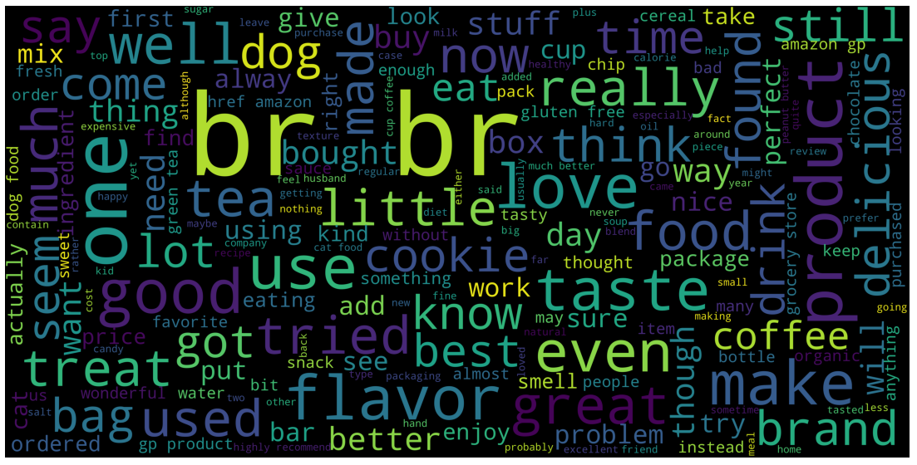
Word cloud on Reviews

Slide 19

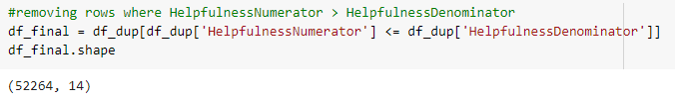
Data cleaning & Text preprocessing
Removing duplicate values -
Helpfulness Numerator - Number of users who found the review helpful
Helpfulness Denominator - Number of users who indicated whether they found the review helpful or not.

Slide 20
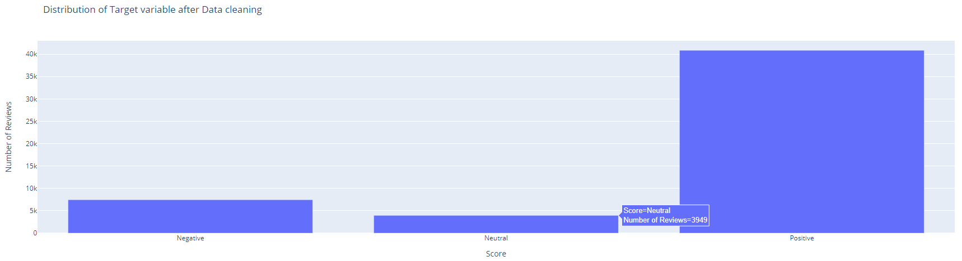
After cleaning the data, size has been reduced -

Slide 21
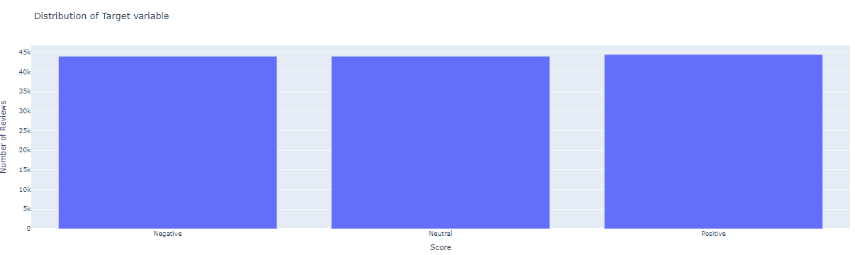
AFTER APPLYING OVERSAMPLING TO THE IMBALANCED DATA :

Slide 22
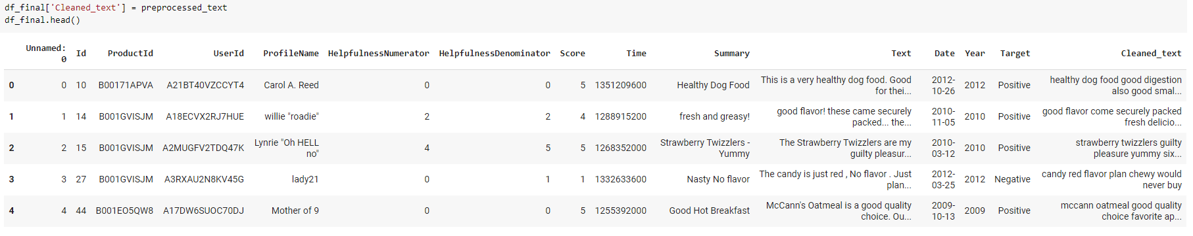
Text Preprocessing -
Removing HTML tags
Removing Punctuation
Removing numbers
Removing URLs
Removing Patterns
Removing contractions
Removing stopwords
Lemmatization
Preprocessed dataset -

Slide 23
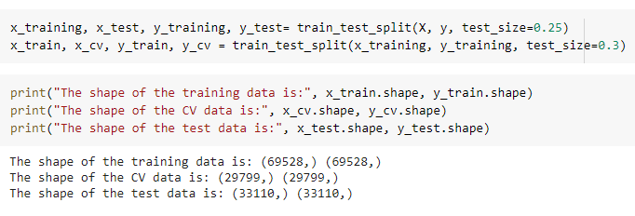
TRAINING &
TESTING SPLIT

Slide 24
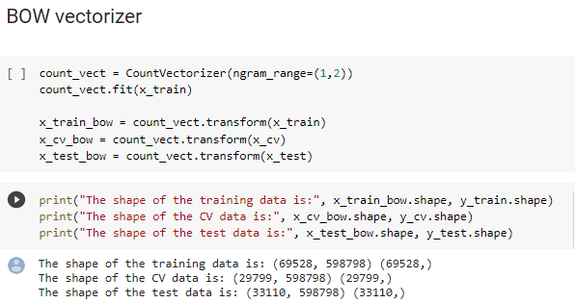
VECTORIZATION

Slide 25
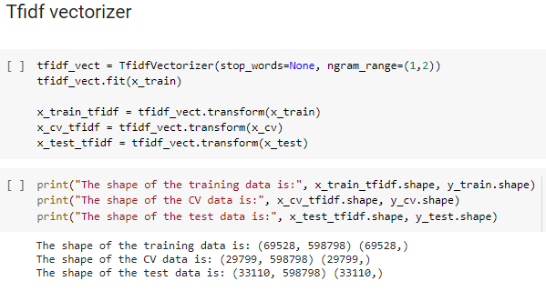

Slide 26
Evaluation
Various Machine Learning model has been applied -
Naive Bayes
Logistic Regression
Support vector machine
Random Forest
Decision Trees
KNN

Slide 27
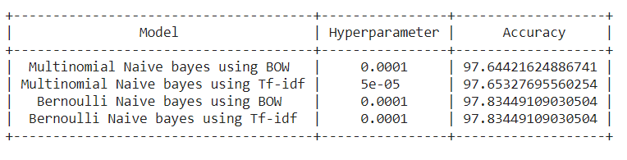
Naive Bayes

Slide 28
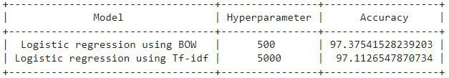
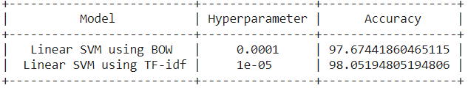
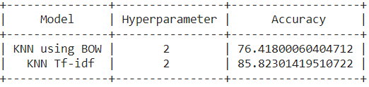
LOGISTIC REGRESSION
SUPPORT VECTOR MACHINE
KNN

Slide 29
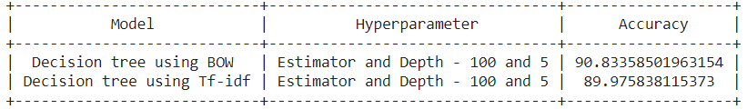
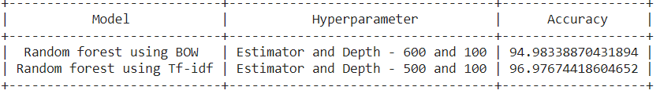
DECISION TREE
RANDOM FOREST

Slide 30
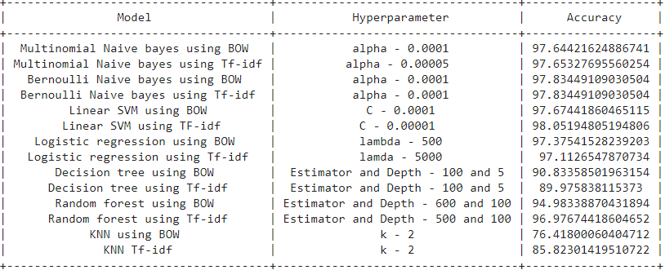
INFERENCE

Slide 31
The main objective was to do sentiment analysis on various Machine learning models.
Among all the machine learning models used Support Vector machine using Tf-idf vectorization performed well with 98% accuracy.
And KNN model using BOW vectorization gave the least accuracy which was 76.41%

Slide 32

SOFTWARE /
TOOLS REQUIREMENT
PROGRAMMING LANGUAGE : Python
ENVIRONMENT : Google Colaboratory

Slide 33
REFERENCES
https://www.kagge.com/snap/amazon-fine-food-reviews
https://monkeylearn.com/sentiment-analysis/
https://towardsdatascience.com/sentiment-analysis-on-amazon-food-reviews-from-eda-to-deployment-f985c417b0c
https://www.youtube.com/watch?v=VXt9SQx5eM0&t=147s

Slide 34
THANK YOU

